Slide 1
GLIDE: Towards photorealistic image generation and editing with text-guided diffusion models
A Nichol, P. Dhariwal, A. Ramesh. “GLIDE: Towards photorealistic image generation and editing with text-guided diffusion models”, In Proc. of the 39th International Conference on Machine Learning, 2022, pp. 16907-16921. Available: https://arxiv.org/abs/2112.10741
2025-02-25
Sein Choi
Intelligent Vision Processing Lab. (IVPL)
https://ivpl.sookmyung.ac.kr
Div. of AI Engineering, Sookmyung Women’s University
E-mail: csi1806@sookmyung.ac.kr

Slide 2
Contents
Introduction
Guidance
Guided Diffusion Model (Classifier Guidance)
Classifier-free Guidance
CLIP Guidance
Training
AMD Model
Results
Qualitative
Quantitative
Safety considerations / Conclusion

Slide 3
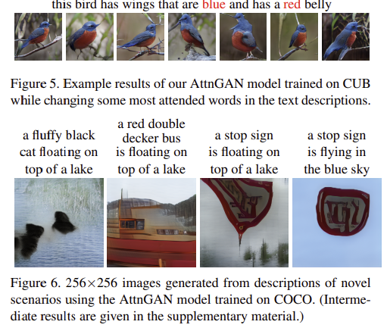
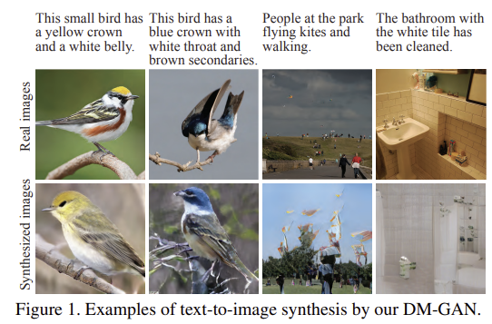
Introduction
Text-Conditioned Model / Diffusion Model
Text-conditioned models cannot generate photorealistic images capturing all text aspects, while diffusion models provide high fidelity and can synthesize photorealistic images.
Class-Conditional Setting
In a class-conditional setting, diffusion models achieve photorealism by balancing diversity and fidelity through classifier guidance.
CLIP guidance and classifier-free guidance enable the generation of photorealistic samples.
Image Inpainting
Fine-tuning is conducted for image inpainting to handle complex prompts.
GLIDE (Guided Language to Image Diffusion for Generation and Editing)
A text-conditioned model focused on generating and editing photorealistic images.

Slide 4
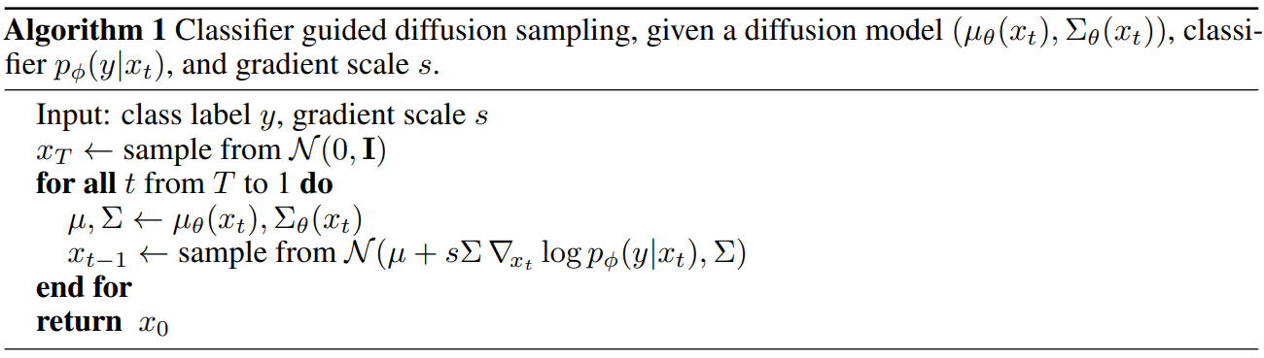
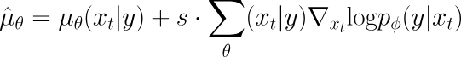
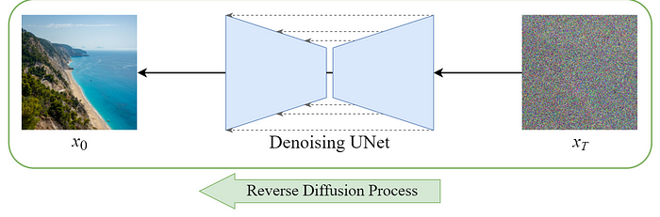
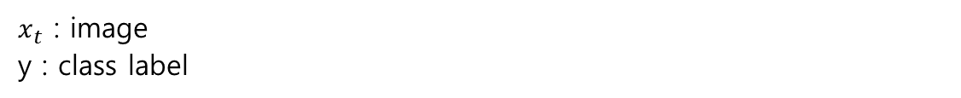
Guided Diffusion Models (Classifier Guidance)
Paper: P. Dhariwal and A. Nichol, "Diffusion Models Beat GANs on Image Synthesis," May 2021. Available: https://arxiv.org/abs/2105.05233, presented at the 35th Conference on Neural Information Processing Systems (NeurIPS 2021).
Propose methods to improve diffusion models' performance over GANs while enhancing both fidelity and diversity
Gradient
Classifier
guidance
$x_{t}$ : image
y : class label
s : guidance scale fidelity diversity

Slide 5
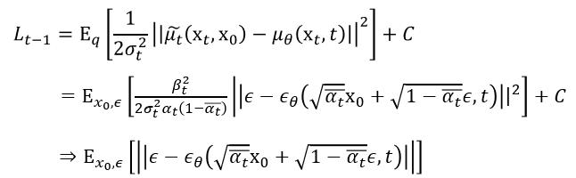
Classifier-free Guidance
Paper: H. Jonathan and S. Tim, "Classifier-Free Diffusion Guidance ," Jul 2022. Available: https://arxiv.org/abs/2207.12598, presented at the 35th Conference on Neural Information Processing Systems (NeurIPS 2022).

Slide 6
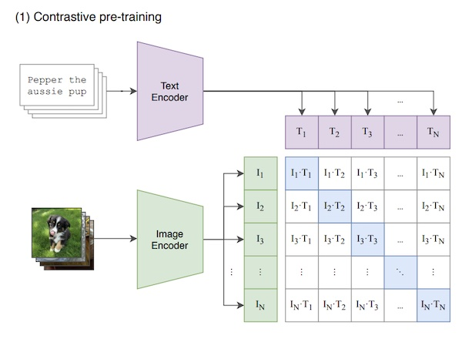
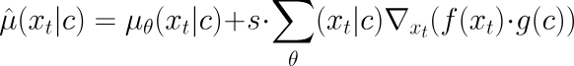
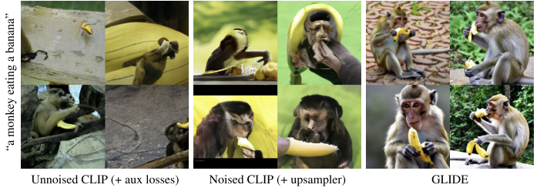
CLIP Guidance
Paper: Alec Radford, Jong Wook Kim. (2021). Learning Transferable Visual Models From Natural Language Supervision, In Proc. of the 38th International Conference on Machine Learning, pages 8748–8763. PMLR. [Online]. Available: https://arxiv.org/abs/2103.00020

Slide 7
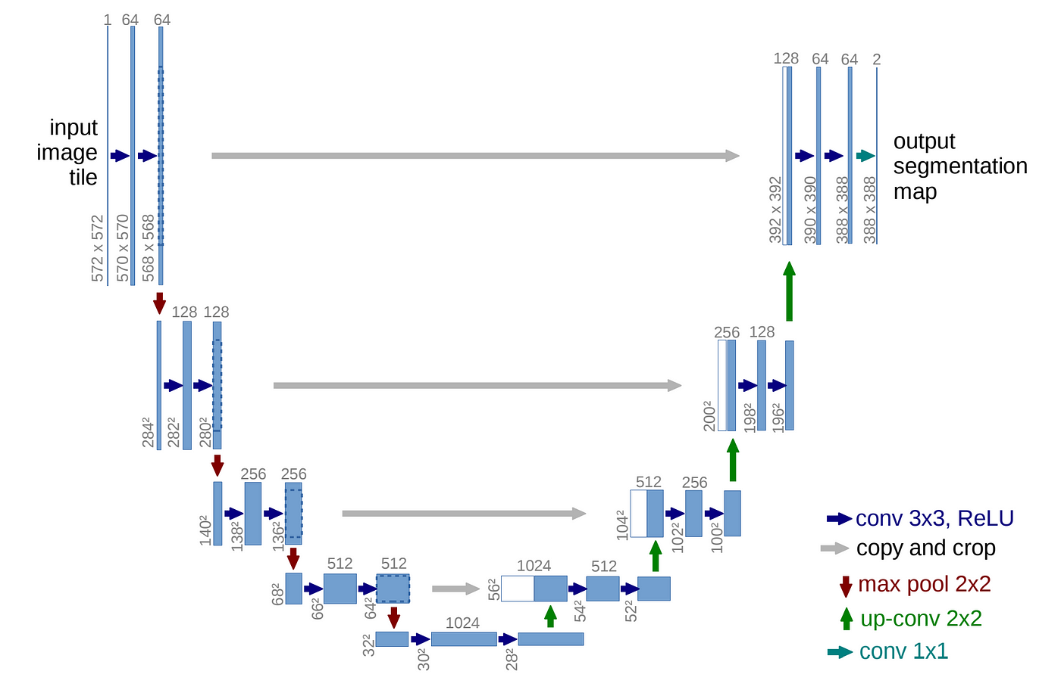
Training
Paper: P. Dhariwal and A. Nichol, "Diffusion Models Beat GANs on Image Synthesis," May 2021. Available: https://arxiv.org/abs/2105.05233, presented at the 35th Conference on Neural Information Processing Systems (NeurIPS 2021).
ADM Model
ADM
variable width with 2 residual blocks per resolution
multiple heads with 64 channels per head
attention at 32, 16 and 8 resolutions
BigGAN residual blocks for up and downsampling
AdaGN for injecting timestep and class embeddings into residual blocks
ADM + transformer module (for text input)

Slide 8
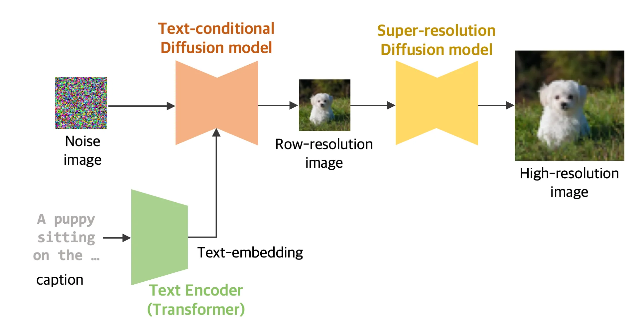
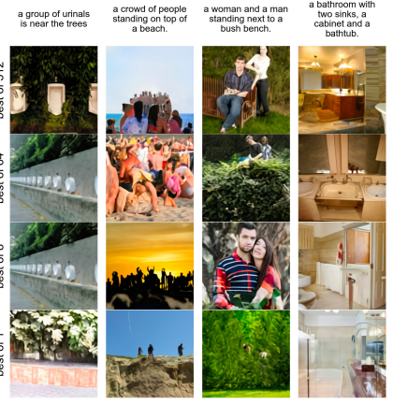
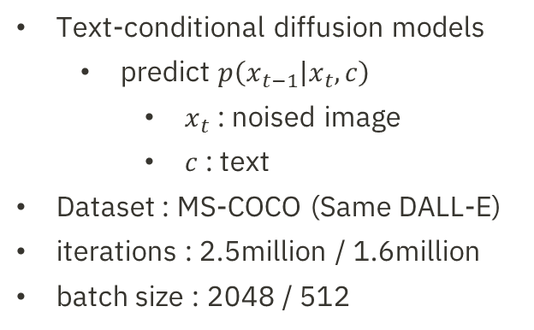
Training
3.5 billion parameters
(ADM model)
1.5 billion parameters
= upsampling
+ Guidance
(classifier-free / CLIP (64x64 ViT-L CLIP)
Text-conditional diffusion models
predict $p\left(x_{t−1} | x_{t},c\right)$
$x_{t}$ : noised image
$c$ : text
Dataset : MS-COCO (Same DALL-E)
iterations : 2.5million / 1.6million
batch size : 2048 / 512

Slide 9
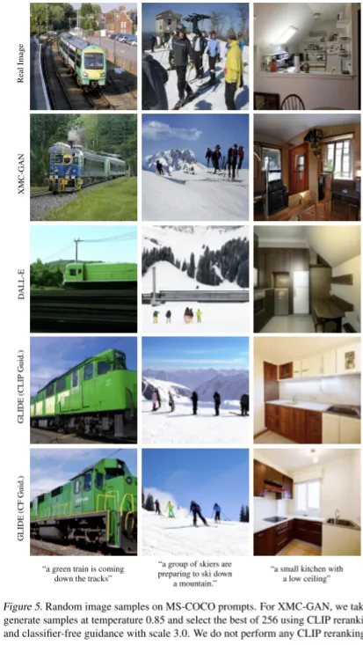
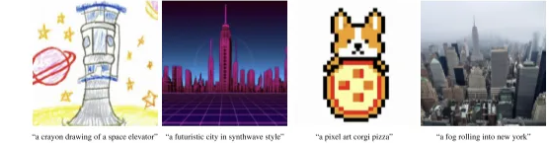
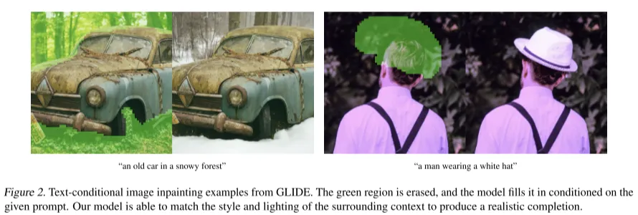
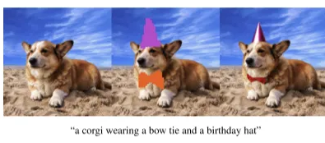
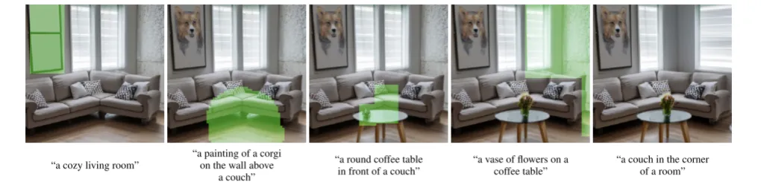
Qualitative Results
CLIP guidance
vs. Classifier-free guidance
Classifier-free guidance
(produce artistic rendering, photorealistic image)
Text-conditional image inpainting
Generating complex image – iteration inpainting

Slide 10
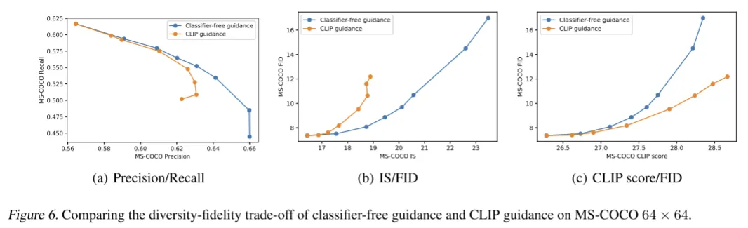
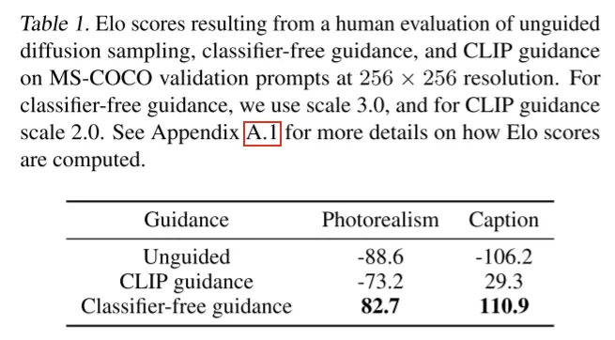
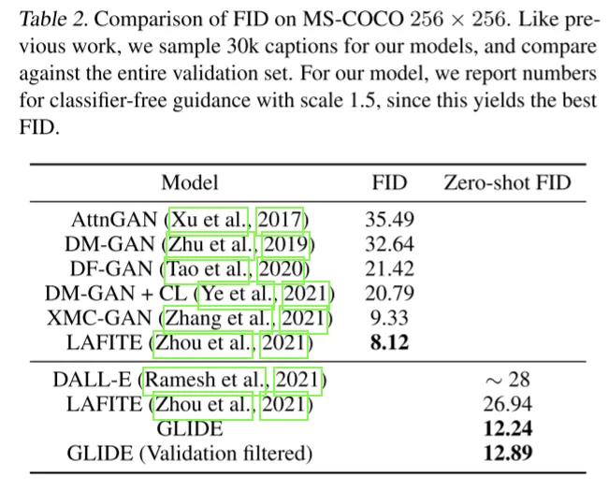
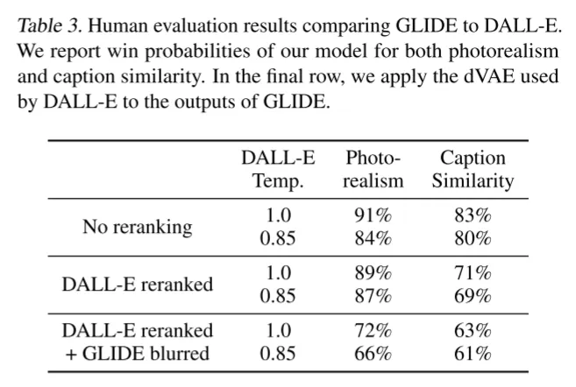
Quantitative Results

Slide 11
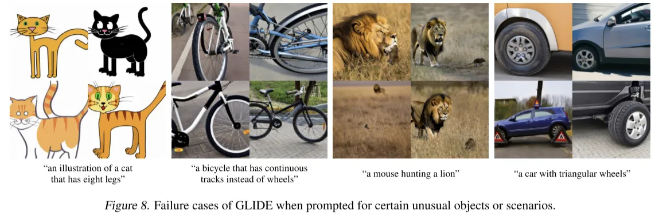
Safety considerations / Conclusion
Safety considerations
The model can create realistic fake images, enabling users with low technical skills to produce misinformation or deepfakes.
Its samples may reflect dataset biases, perpetuating social biases.
So, implement data filtering and experiments before deployment (e.g., avoiding face restoration and reducing hateful image generation).
Limitations
Complex Combinations
Sampling Speed
Conclusion
GLIDE demonstrates high performance in the text-to-image field by using a diffusion generation model that employs classifier-free guidance

Slide 12
Thank you for your attention.!!!
QnA

